Slide 1
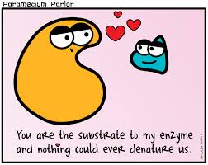
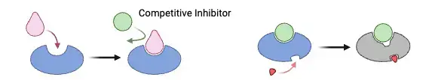
Station 1- Enzymes
Label the terms on the diagram on your handout:
  Enzyme
  Substrate
  Active Site
  Enzyme substrate complex
  Products
Label the diagrams below as either competitive or non-competitive inhibition. How are these two processes different?

Slide 2
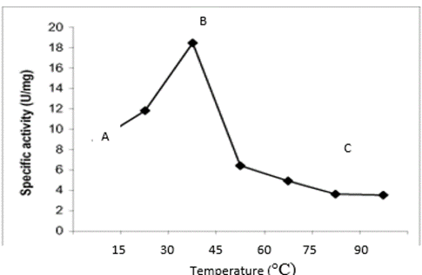
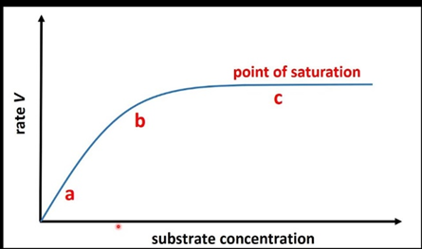
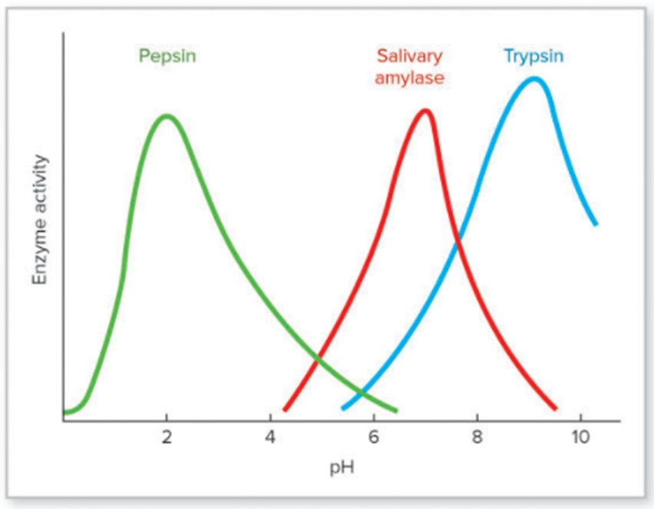
Station 1 Cont.- Enzymes
Answer the questions related to the graphs below on your handout.
Graph B
Graph C
Graph A

Slide 3
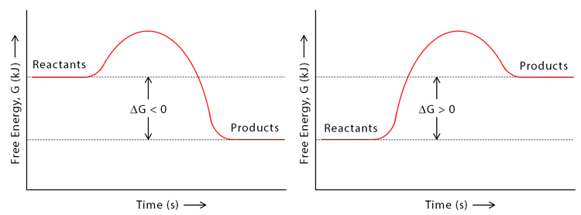
Station 2-Energy
Label the parts of the graphs below with reactants, products, and where energy is either being released or added. Indicate if the graph represents an endergonic or exergonic reaction.
Graph A
Graph B

Slide 4
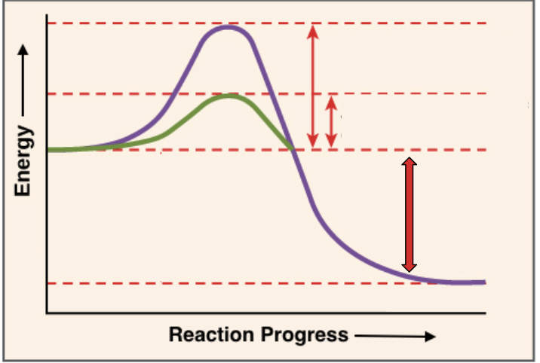
Station 2 Energy Cont.
Label the enzyme graph with the following:
  Reaction with the enzyme
  Reaction without the enzyme
  overall energy released
  reactants
  products
  activation energy with the enzyme
  activation energy without the enzyme
How do enzymes speed up the rate of chemical reactions?

Slide 5
Station 3- Relating Cellular Respiration and Photosynthesis
Fill in the chart below in your handout. How are cellular respiration and photosynthesis related processes?
 | Cellular Respiration | Photosynthesis
Role of Oxygen?
Role of CO2?
Role of Glucose?
Role of Water?
Role of ATP?
WHO does it?
WHERE does it occur in the cell?
WHY does it occur?

Slide 6
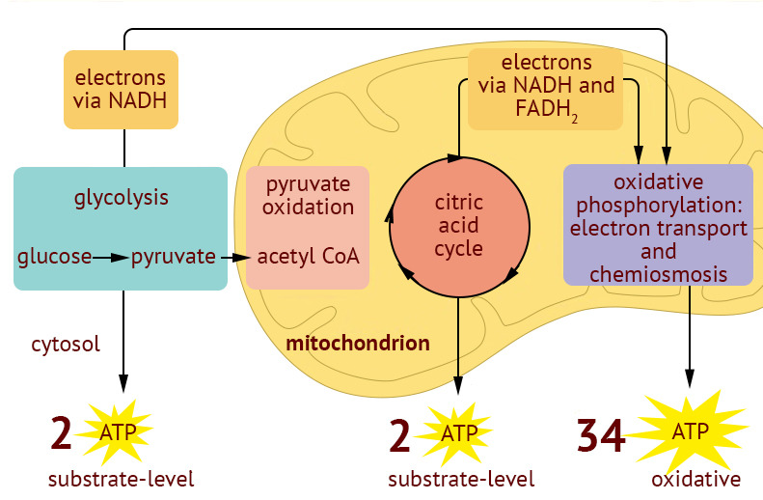
Station 4- Cellular Respiration
Complete the graphic organizer in your handout summarizing the steps to cellular respiration. Answer the questions that follow.

Slide 7
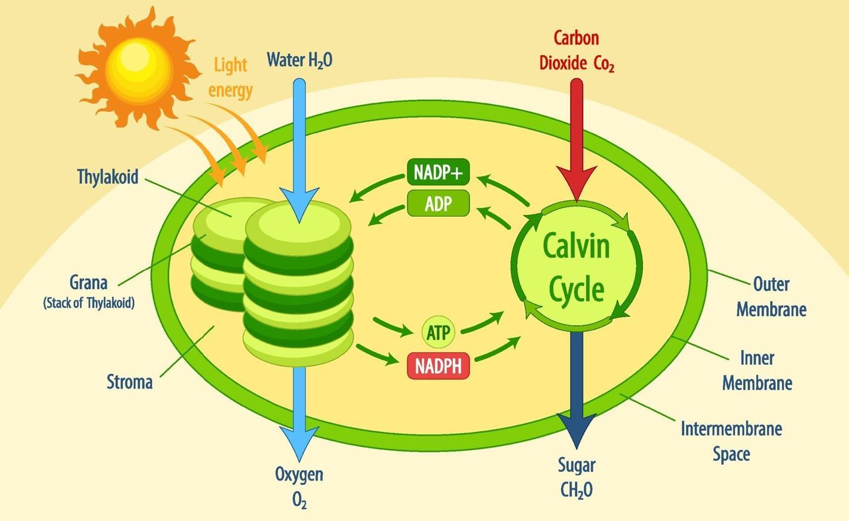
Station 5- Photosynthesis
Complete the graphic organizer in your handout summarizing the steps to photosynthesis. Answer the questions that follow.

Slide 8
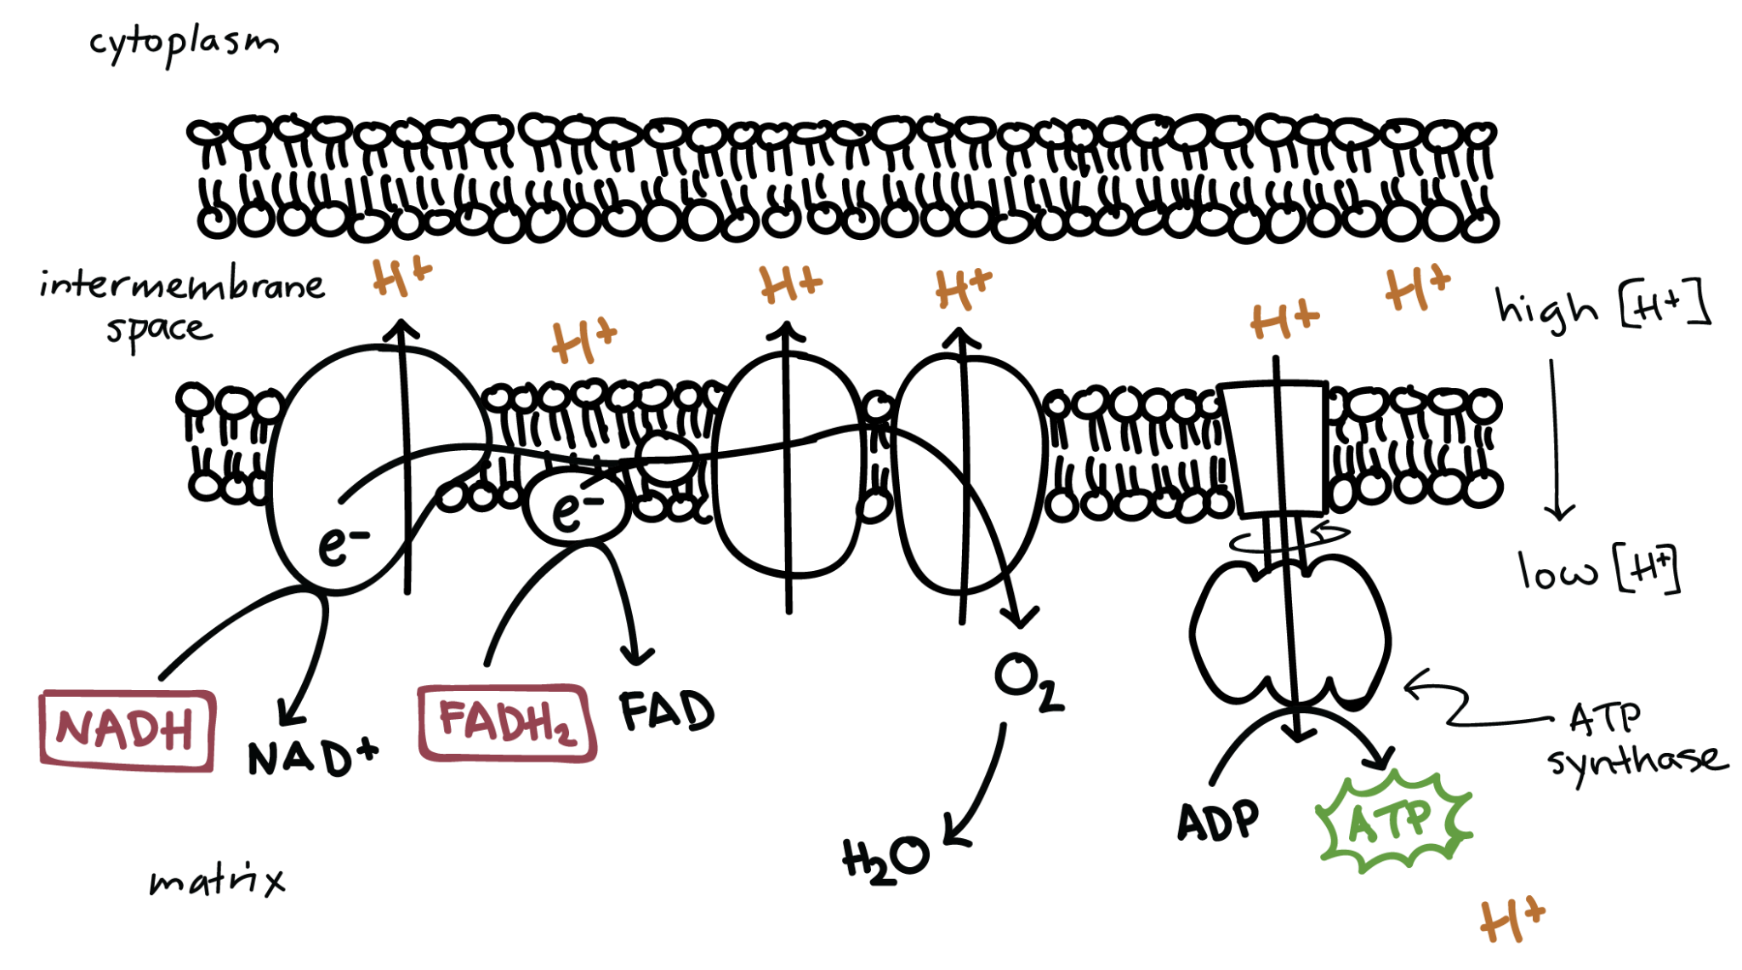
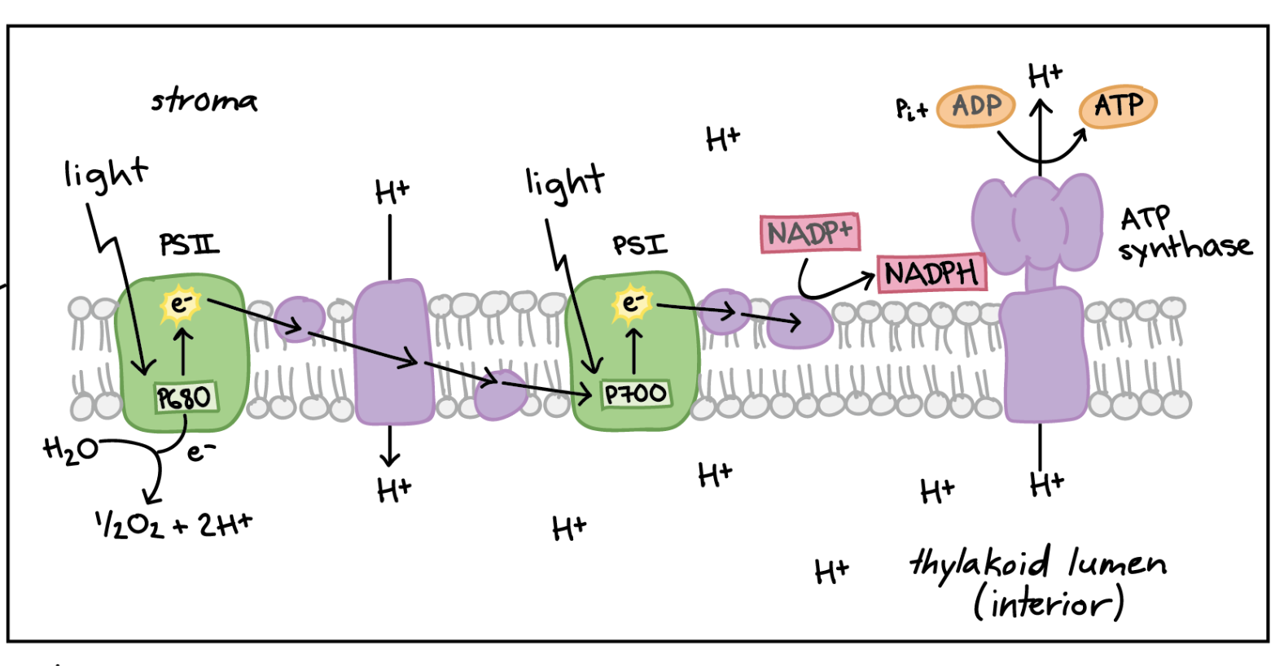
Station 6 -The ETC
Label the diagrams of the ETC in your handout.
ETC- Cellular Respiration | ETC- Photosynthesis

Slide 9
Station 6 Cont.-The ETC
Complete the chart below summarizing the differences between the ETC in photosynthesis and cellular respiration.
 | Cellular Respiration | Photosynthesis
What is the purpose of the ETC?
Who are the electron carriers?
Where is the ETC located?
What supplies energy for the ETC?

Slide 10
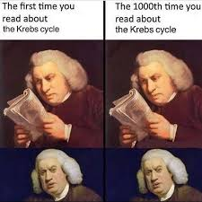
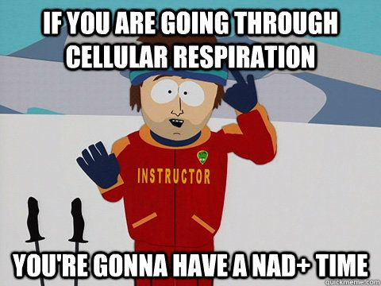
Station 7- CR Practice Questions
Complete the cellular respiration practice multiple choice questions in your packet. See your teacher for the answer key when you finish.

Slide 11
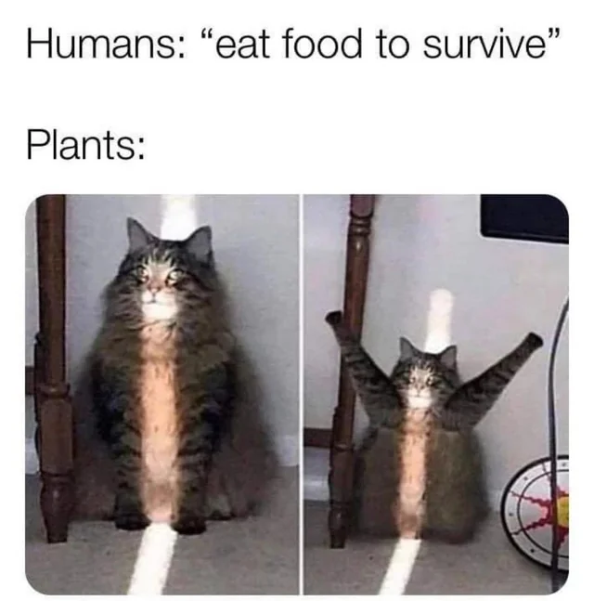
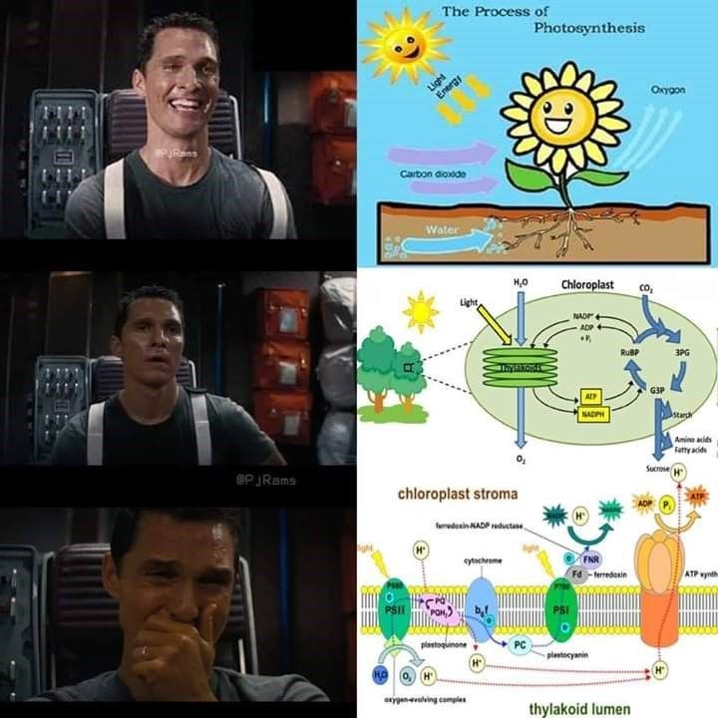
Station 8- PS Practice Questions
Complete the photosynthesis practice multiple choice questions in your packet. See your teacher for the answer key when you finish.

